Slide 1


CAPSTONE PROJECT
PRESENTATION
Metrics
RFM
RFM Calc
Intro
GROUP MEMBERS:
MUHAMMAD TAHA
ZIAULLAH JAN
SHAROON ABDUL KHALIQ
ARSALAN KHATRI
Visualization
RFM (cont.)
DATA ANALYTICS COHORT-3
INSTITUTE OF EMERGING CAREERS

Slide 2

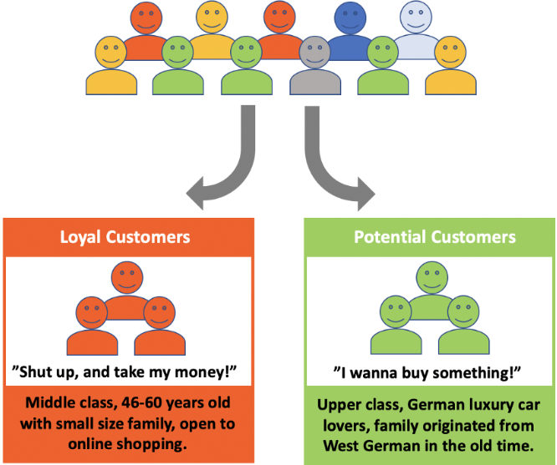
Have you ever wondered how different companies categorize their customers?
Metrics
RFM
RFM Calc
Intro
Visualization
RFM (cont.)
“RFM Analysis is used to identify different types of customers”

Slide 3
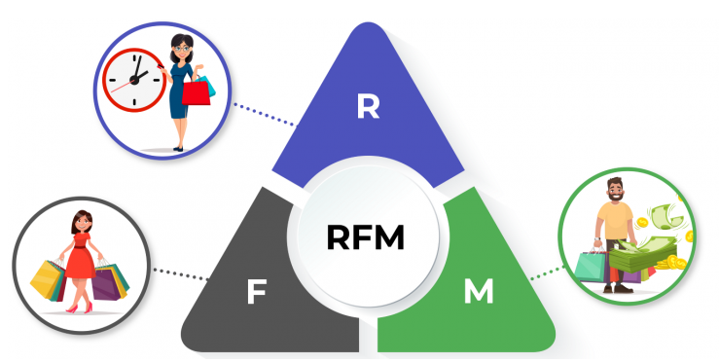
Recency-Frequency-Monetary (RFM)
It is a market analysis tool used to identify a company’s or an organization’s best customers by measuring and analyzing spending habits.
An RFM analysis evaluates clients and customers by scoring them in three categories:
Recency: How recent was the last purchase.
Metrics
RFM
RFM Calc
Intro
Visualization
RFM (cont.)
Frequency: Total number of transactions a customer made.
Monetary: Value of total purchases done by a customers.

Slide 4
Minimum Data Requirements For RFM
Customer Name or ID
Order Date
Order ID
Quantity Ordered
Unit Price
Metrics
RFM Calc
RFM
Visualization
RFM (cont.)
Scoring
Intro
RFM scores are calculated to know the purchase behavior of any customer. It provides a simple intuitive way of calculating each of the three aspects in a simple rating of 1-5, where:
1 is the least important.
5 is the most important one.
For example, a customer with R = 5, F = 5, and M = 5 is most profitable and loyal customer, while a customer with R = 1, F = 1, and M = 1 is the least contributing one.

Slide 5
Recency Value
Recency for customers is calculated by taking the most recent date that the customer has made a purchase.
Frequency Value
Total number of orders made by the customers are counted by counting the order id of each customer.
Metrics
Monetary Value
RFM
Visualization
RFM (cont.)
RFM Calc
Intro
Multiply order quantity of each customer with the unit price of that product.
Quantiles
The next step is to make quantiles from the data, which will divide the data into 5 different groups 20% each, and then assign score to that data between 1 to 5 based on RFM values.

Slide 6
Results
From RFM analysis we get score in the form of a combine table showing Recency, Frequency and Monetary score of a customer as shown in the table
Customer Name | RFM Score
Rattlesnake Canyon | 5 5 5
Simons bistro | 5 2 4
B's Beverages | 3 3 3
Consolidated Holdings | 1 1 1
Metrics
RFM
RFM Calc
Intro
Visualization
RFM (cont.)
Categorization on the Basis of RFM Score
Best Customers: RFM Score = (5, 5, 5)
Loyal Customers: RFM Score = (5, 5, 1)
Churned Best Customers: RFM Score = (1, 5, 5) or (1, 4, 4)
Churned Average Customers: RFM Score = (1, 5, 3) or (1, 4, 3)

Slide 7
CompanyName | Score | Category
Rattlesnake Canyon Grocery | 555 | Best & Loyal Customer
Bon app'
Save-a-lot Markets
White Clover Markets
Ernst Handel
Berglunds snabbkp | 255 | Churned
Vaffeljernet | 244
Que Delcia | 243
Split Rail Beer & Ale | 234
Furia Bacalhau e Frutos do Mar | 233
Ana Trujillo Emparedados y helados | 221 | Least Contributing
La corne d'abondance | 221
The Big Cheese | 212
France restauration | 212
Blido Comidas preparadas | 212
Metrics
RFM
RFM Calc
Intro
Visualization
RFM (cont.)
Lehmanns Marktstand | 554 | Loyal
LILA-Supermercado | 544
Richter Supermarkt | 544
Tortuga Restaurante | 543

Slide 8
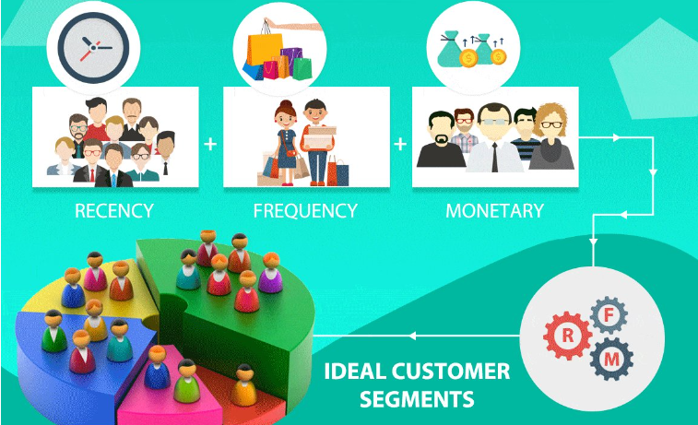
Questions RFM Can Answer
Who are the best or loyal customers?
Who has the potential to become valuable customers?
Which of your customers can be retained?
Who of those inconsistent customers who don’t engage regularly with the store?
Which group of customers is most probable to respond to your campaign?
Who are the churned out customers?
Metrics
RFM
RFM Calc
Intro
Visualization
RFM (cont.)

Slide 9

Other Metrics From The Data
Retention Rate of Customers
Churn Rate of Customers
Top 5 Categories
Top Regions
Top 5 Products in Each Category
RFM
Metrics
RFM Calc
Intro
Visualization
RFM (cont.)
Top 2 Categories of Each Individual
Top Employees
Monthly Customer Trends
Total Cost of Shipment

Slide 10
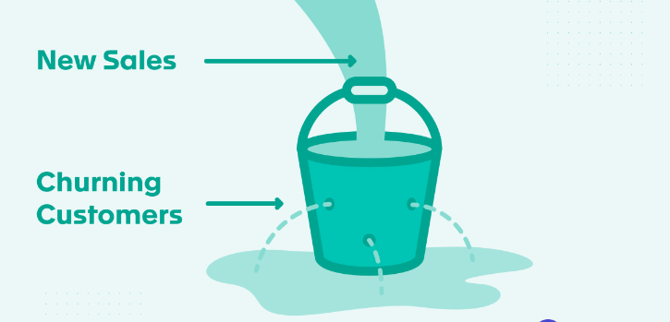
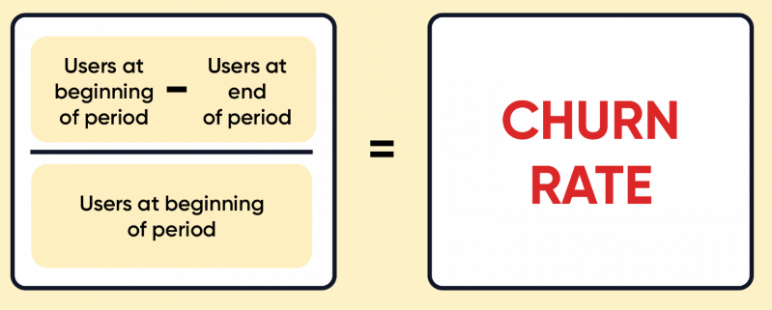
Churn Rate
Are Customers turning their back on your business? This is called churn of customers.
It is the rate at which customers stop doing business with the company over a given period of time.
Top 5 Reasons Why Customers Churn
They are not getting value out of the product.
Customer needs have changed.
Financial concerns.
Customers service issues.
The product has issues.

Slide 11
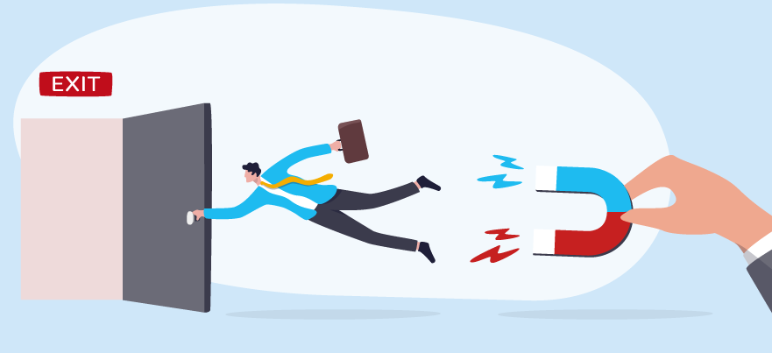
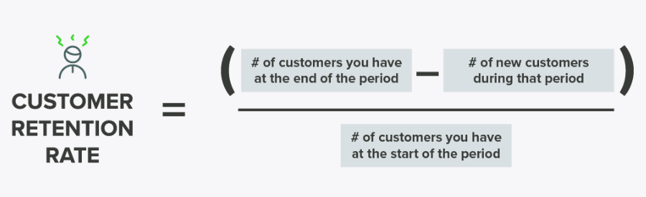
Retention Rate
A percentage of customers’ business retains over a period of time. A high retention rate logically shows that a business has a low churn rate.
Benefits of Customer Retention
Lower marketing cost.
Repeat purchase means repeat profit.
Word-of-mouth advertising.
Gain valuable feedback.
Sell at premium prices.

Slide 12
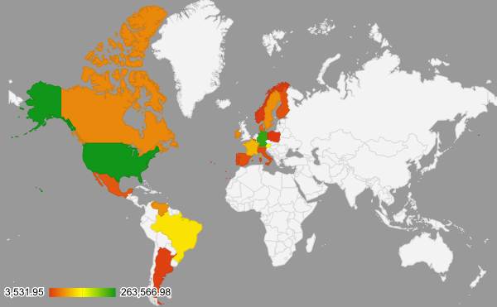
Total Revenue Per Region
ShipCountry | Total Revenue
USA | $ 263,566.98
Germany | $ 244,640.63
Austria | $ 139,496.63
Brazil | $ 114,968.48
France | $ 85,498.76
Venezuela | $ 60,814.89
UK | $ 60,616.51
Sweden | $ 59,523.70
Ireland | $ 57,317.39
Canada | $ 55,334.10
Belgium | $ 35,134.98
Denmark | $ 34,782.25
Switzerland | $ 32,919.50
Mexico | $ 24,073.45
Finland | $ 19,778.45
Spain | $ 19,431.89
Italy | $ 16,705.15
Portugal | $ 12,468.65
Argentina | $ 8,119.10
Norway | $ 5,735.15
Poland | $ 3,531.95

Slide 13
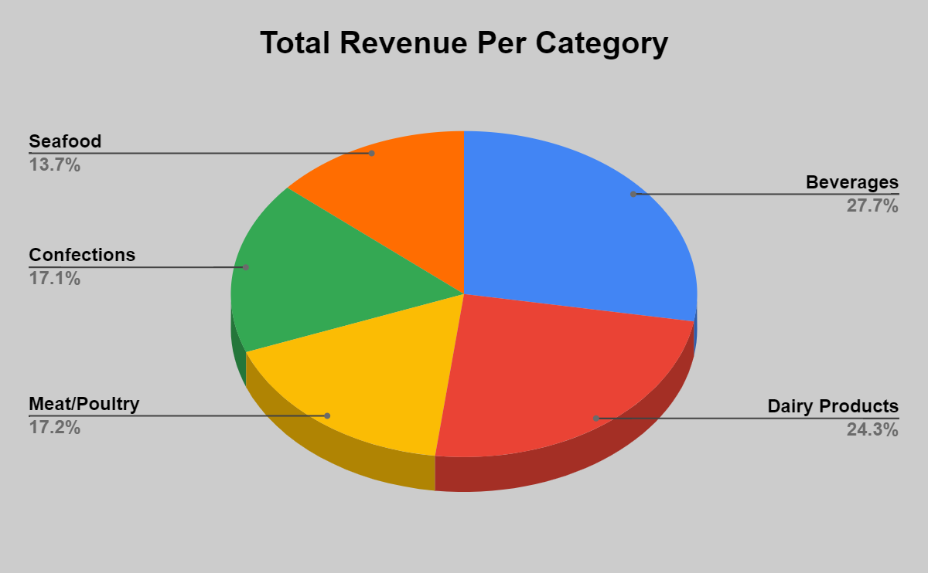

Slide 14
Top 2 Products of Each Customer

Slide 15
Top 5 Products In Each Category

Slide 16
Monthly Customer Trends
This line chart shows the monthly customer trend over the three years time.

Slide 17
Top 5 Employees
These are the top 5 employees of the company. Bonuses and incentives can be given to these employees.

Slide 18
Shipment Cost of Shippers
This graph shows the total freight of different shipping companies.

Slide 19
THANK YOU

